Slide 1
ISM 6562
Big Data for Business
Dr. Tim Smith

Slide 2
Guiding Agenda
12:30-12:35 - Class Agenda
12:35-12:55 - Introductions
12:55-01:10 - Review syllabus
01:10-01:40 - Install Anaconda, demonstrate how to start jupyter lab, save files, concept of cells, markdown, etc.
Break
01:40-02:40 - Introduction to Analytics, Data Mining, and Big Data
Rationality in decision making
The rise of big data
Scaling for big data
02:40-02:50 - Introduce DataCamp, get everyone signed up
02:50-03:00 - Class recap, questions, deliverables this week, and preparing for next class01

Slide 3


Meet your professor
Dr. Tim Smith
PhD in Business Information Systems
Research Interests include technology adoption , organizational routines, health information technology, and application to deep learning models to cryptocurrency and blockchain. Coauthoring a textbook on Business Analytics (Prospect Press).
20+ years of professional experience
Systems programmer
Founder, and president of a software development company
Systems Architect
Telecom Executive
In my spare time, I like to travel, hike, fly-fish, and play guitar.

Slide 4
Introduce Yourselves
Introduce yourself to the class
Tell them your name, and one interesting thing about yourself:
i.e., mine was that I played lead guitar in a heavy metal band

Slide 5
Course Introduction

Slide 6
ISM6562 – Big Data for Business
Review Syllabus
Review Academic Integrity Policy (Cheating)
Review Canvas and how to navigate course content

Slide 7
The Rise of Big Data

Slide 8
Learning objectives
Understand what Solow’s Paradox is/was, and how this is changing in today’s data driven world.
Understand big data, and the 6v’s
Situate Data Mining and Data Analytics within the large scope of data science.
Describe the four types of data analytics.
Describe some examples of the use of data analytics in business.

Slide 9

1987….
“You can see the computer age everywhere but in the productivity statistics“.
Robert Solow, 1987

Slide 10

Today…
Since 2002, the top 5% of companies have increased productivity by 40%, while the other 95% of companies have barely increased productivity at all.
Andy Haldane, Chief Economist for the Bank of England

Slide 11
What explains this?
Some companies have found a solution to Solow’s Paradox and are rapidly improving their productivity.
Economists continue to explore what’s behind this trend, but a few things are clear
The Internet is increasing the rate of consolidation in many industries.
Differentiation is even more important today!
Effective use of data analytics and machine learning are being leveraged to improve and automate business processes and decision making.
Clearly, some companies do a better job at this than others!
Data, and access to information from this data is driving tremendous competition advantage and growth.

Slide 12
Data is everywhere…
2.5 quintillion bytes of data generated each day
Over the last two years, we’ve generated 90% of all the data that has ever been generated!
We conduct more than half of our web searches from a mobile phone now.
More than 3.7 billion humans use the internet (that’s a growth rate of 7.5 percent over 2016).
On average, Google now processes more than 40,000 searches EVERY second (3.5 billion searches per day)!
See the infographic here (https://web-assets.domo.com/blog/wp-content/uploads/2017/07/17_domo_data-never-sleeps-5-01.png)

Slide 13
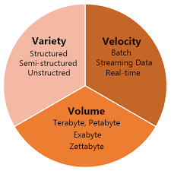
Big Data: The 3vs
Volume: This refers to the amount of data. With the advent of the internet and the rise of cell phone use and IoT, we are seeing exponential growth in data produced.
Variety: The variety of data is expanding – videos, audio, web interactions, geographic location, images, emails, etc.
Velocity: The speed of data production is increasing.
In 2022, 333.2 billion emails are sent every day.
In 2021, people created 2.5 quintillion bytes of data every day.
In 2022, users sent around 650 million Tweets per day.
In 2021, people created 2.5 quintillion bytes of data every day.

Slide 14
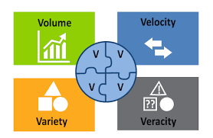
Other Systems: Big Data – 3Vs and 4Vs
Veracity: Refers to the quality of the data; where the data has been collected from, how it was collected, and how it will be analyzed.
The veracity of a users data, dictates how reliable and significant the data really is.

Slide 15
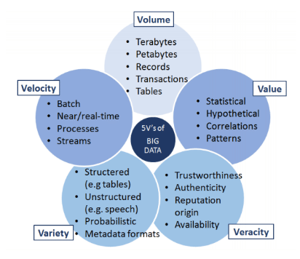
Other Systems: Big Data – 5 Vs

Slide 16
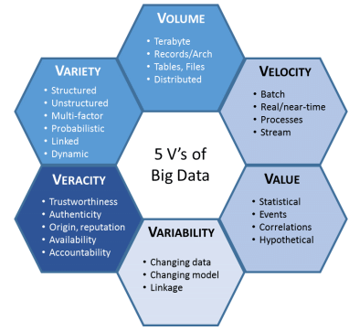
Other Systems: Big Data – 6 Vs
6 V’s of Big Data
Note: Some experts have kept adding new V’s (i.e., 17!) – but beyond 6 is probably not necessary or valuable.

Slide 17
History of Big Data
The term was coined in the 90s
typically credited to John Mashey from Silicon Graphics
But, we have been dealing with ‘big data’ challenges since ancient times:
300 BC: Attempt to capture all existing ‘data’ in the Alexandria library
Roman Empire analyzed data to determine optimal distribution of their armies

Slide 18
Big Data Phase 1 | Big Data Phase 2 | Big Data Phase 3
Period: 1970-2000 | Period: 2000-2010 | Period: 2010-present
RDBMS Based structured content: RDBMS and Data Warehousing | Web-based Unstructured content: Information retrieval and extraction | Mobile and Sensor Based Content Entity-centered analysis (i.e., person)

Slide 19
From a business perspective
How do you store and process the data in a specific use-case scenario?
Will a single computer suffice?
Can we utilize a single system, or ‘scale up’ the capacity of a single system to handle the job?

Slide 20
Vertical vs Horizontal Scaling
Big Data systems make distributing storage and processing across multiple nodes easier to accomplish
What was extremely technically challenging and costly to do has become much easier and less costly.

Slide 21
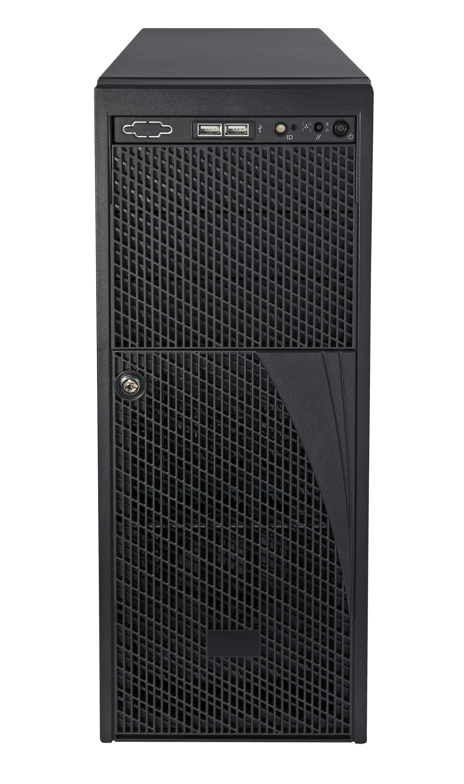
Vertical Scaling
Increase the number of CPU cores
Increase the amount of RAM
Increase the storage disk space

Slide 22
Horizontal Scaling
Increase the number of systems
Utilize systems/software technologies that distribute storage and processing across multiple computers

Slide 23

How much performance does the use case require?
Multi-Node
Performance
Single Node
Cost

Slide 24
Discussion
What’s an RDBMS?
What are they good for? What contexts are they possibly not the best solution?

Slide 25
Scaling – Incorporating Big Data Systems
Horizontal Scaling
Performance
With big data tools and technologies
Horizontal Scaling
Vertical Scaling
Modern RDBMs can scale horizontally, but not as well as big data systems.
Cost

Slide 26
DataCamp

Slide 27
Data Camp
Accept invitation and create account using USF email
To verify you have successfully created your account, take the Understanding and Interpreting Data assessment
…your performance on this is not graded – completing it results in full marks)

Slide 28
Summary

Slide 29
Summary
We have reviewed the syllabus, canvas, and datacamp.
You are now subscribed to datacamp and can begin working on the assigned courses.
You understand some of the challenges of big data analytics
You know the 3+ V’s of big data
You understand the benefits and costs of vertical versus horizontal scaling

Slide 30
Next Week
Setup development environment.
Review development environment navigation and tools for this class.
Create your github repo
We will write our first programs for this class
Focus your week on complete datacamp courses, and brushing up on your Python skills.

Slide 31
To do List for this week:
Work on the assigned DataCamp courses.
Introduction to Shell (by Aug 30th): <3hrs
GitHub concepts (by Aug 30th): <2hrs
Introduction to SQL (by Sept 6th): <2hrs
Intermediate SQL (by Sept 6th): <3hrs
Two chapters on Docker (due by Sept 13th)
Introduction to Docker: What is Docker?
Introduction to Docker: Using Docker Containers

Slide 32
Happy Learning!

